Slide 1
Machine Learning in Allocating and Building our Stock Portfolio

Slide 2
Hello!
I am Aprian Immanuel (Rian)
Background:
Active/Passive Investor and Trader (2017 – now)
Material Engineer (2016 – now)
Entrepreneur (2016 – now)
I am here because I want to share how to be a Data Driven Investor.
You can find me at @aprianimmanuel / immanuelaprian@gmail.com

Slide 3
Background
STOCK TRADING
Non-performing assets can cause immense losses. However, if we have ML for assesment of the assets, the system delves deeper and digs to find out all relevant information
This one area where price is influenced not just by demand-supply but also by political factors, climate, company results and unforeseen calamities.
ML keeps track of all and integrates them into a predictive capability to keep us ahead of the game
THE RIGHT DECISIONS
Making the right decisions and grabbing opportunities in the fast moving world of finance can make a difference to your bottom line
This is where machine learning and artificial intelligence make a tangential difference
Market and Markets study shows that artificial intelligence in financial segment will grow to over $ 7.3 billion in 2022
Likewise, investments in other areas like bonds, mutual funds and real estate need to based on smart analysis of present and future while factoring external influencers. Therefore, if we have machine learning based system it would keep track of developments and alert us in advance so that we can be prepared.

Slide 4
OUR GOAL
1
We know how to build our long term porfolio for Investor, Fund Manager, and other stakeholders with fully concern in maintaining and calculating the risk using Machine Learning Model

Slide 5

Final Project Workflow
Acquiring Dataset (Download financial statement from all public company listed in IDX)
Manually copying into dataset formed in SQL and CSV
Querying SQL (Exploratory Data Analysis) – New dataframe acquired!
Model Building and Return based Evaluation (Hierarchical and KMeans Clustering)
Domain Knowledge and Literature Study

Slide 6
Risk comes from not knowing what you are doing – Warren Buffet

Slide 7
Dividend Investing
With recurring dividend payments, we invest in for as long as the company can support them, regardless of whether the company’s stock price is up or down

Slide 8

What to look for when investing in dividends
Dividend safety
When looking at where to invest or buy a share, we seek dividend safety, which is typically measured by the dividend payout ratio. If the stock dividend payout ratio is high, then that company is likely a safe choice for dividend investing
High Yields
A dividend yield is a calculation that determines how much money we will earn for every rupiah invested at the current price based on the current dividend rate. To calculate it, we divide our cash dividend by the share price.

Slide 9

Beware of Dividend Traps
Dividend Yield are on a par
We can look at the other companies in the same industry and compare their dividend yields to make sure they are on a par. High yield can sometimes indicate that a company is in financial trouble
High Dividend Growth Rate
Investors buy stock in companies that currently paying lower than average dividend, but are growing extremely quickly.
Industry Health
We can look at the industry’s history and the current climate around it; for example, many investors speculate that healthcare services will boom in the next two or three decades.

Slide 10

How to decide if dividend investing is a good idea
Dividend are generally considered a sign of good financial health.
Dividend investing is a great way to build wealth through compounding.
However dividends are not a guarantee and can subjet to certain company related and economy risk.
It is also difficult – if not impossible - to make any significant money from dividend if we don’t have significant money on hand to invest.

Slide 11

We must determine if investing is worth the risk in the stock market and if we are willing to wait to see a return on our investment

Slide 12
Analysis for Risk Management in Stock Market Investing
Fundamental Analysis
Stock Market Investing
Technical Analysis
Sentiment Analysis

Slide 13
Workflow
Fundamental Analysis
Technical Analysis
Evaluation and Conclusion
Acquiring Dataset. SQL Querying. Financial Statement Fact Finding.
Portfolio Selection K-Means Clustering and Allocation using Hierarchical Clustering, and its Varian
Conditional Drawdown at Risk Metrics, Expected Shortfall Risk Metrics, etc
1
2
3

Slide 14
Fundamental Analysis
Financial Statement Fact Finding | SQL Querying | Exploratory Data Analysis

Slide 15
Fundamental Analysis and Fact Finding
Finance
Mining
Consumer Goods Industry
Agriculture
Infrastructure, Utilities and Transportation
Basic Industry and Chemicals
We are looking for a public company which has big and dividend payment, High dividen payout ratio, Less debt, and has good liquidity ratio
Property, Real Estate and Building Construction
Trade, Service and Investment
Miscellaneous Industry
We used conditional selection with SQL Querying and acquiring new dataframe contained our new public company list.

Slide 16
1st Dataset Feature
CompanyName | CodeName | Subsector | MRQuarter | FinYrEnd | IssShare | StInd | Sales | Assets | Liability | Equity | CashFlow | OpProfit | NetProfit | DPS | EPS | RPS | BVPS | CFPS | NAVS | DivYield | PER | PSR | PBVR | PCFR | DPR | GPM | OPM | NPM | EBITM | ROE | ROA | DER | CR | QR | CRR

Slide 17
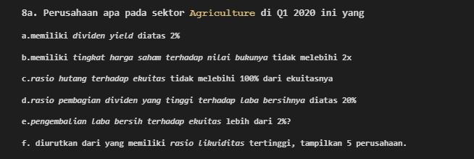

1. Agriculture

Slide 18
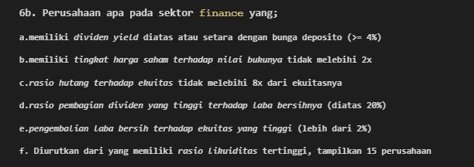
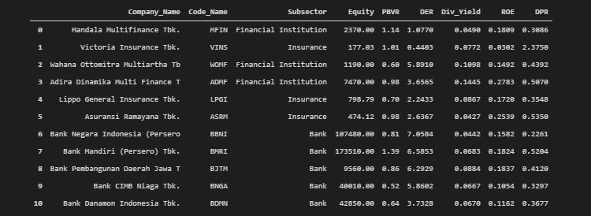
2. Finance

Slide 19
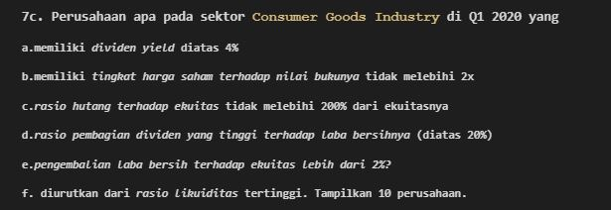
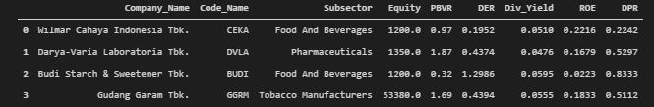
3. Consumer

Slide 20
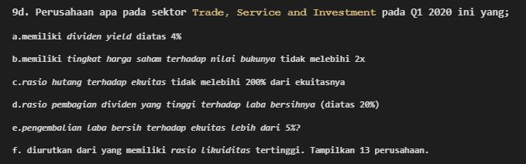
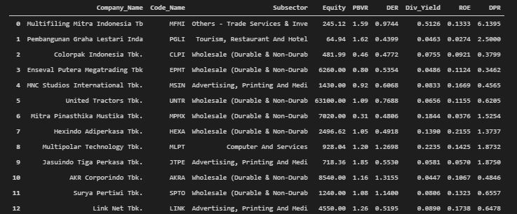
4. Trade

Slide 21
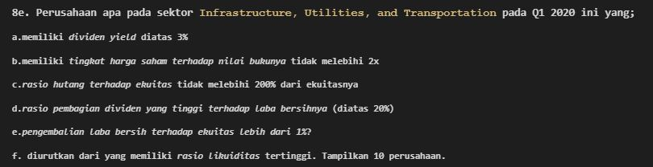
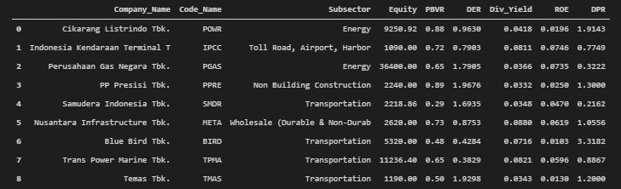
5. Infrastructure

Slide 22
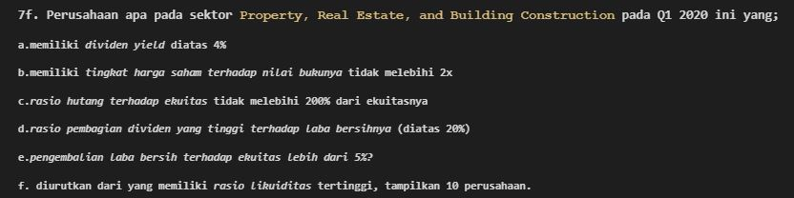
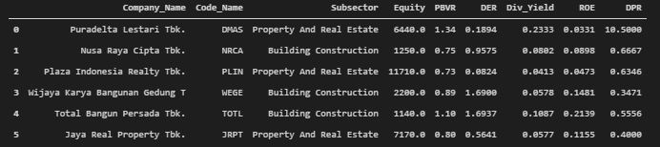
6. Property

Slide 23
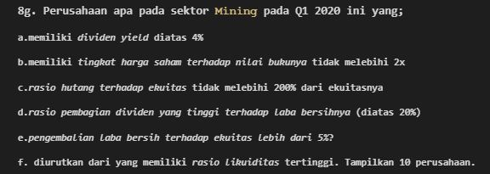
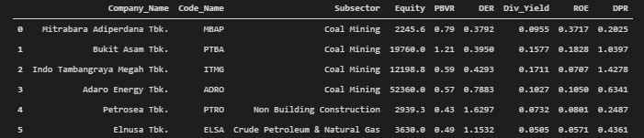
7. Mining

Slide 24
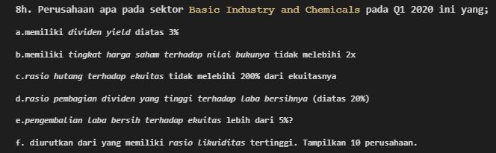

8. Basic Industry

Slide 25
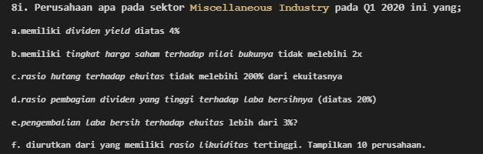
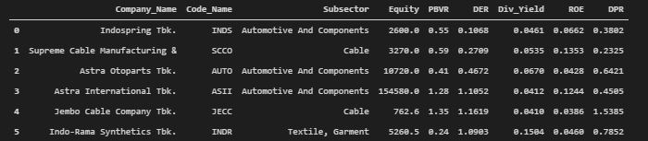
9. Misc. Industry

Slide 26
Technical Analysis
Portfolio Selection and Allocation | Model Building (Clustering) | Return Based Evaluation

Slide 27
Technical Analysis Workflow
Importing Historical stock prices data from 2015 – 2020 from Yahoo Finance
Plotting the volatility of the stock price. The more increase of volatility, the investment is of greater risk
Build Portfolio using several portfolio strategy
Evaluation
Domain Knowledge and Literature Study

Slide 28
Portfolio Selection using Clustering

Slide 29
Why do we need and use Clustering?
We want to make sense of and extract value from our dataset, in this case, financial statement and stock price dataset, to build our own better strategy in our investment.
However, we had no clue what to do in this case. This because we didn’t know yet the structure of the data. They are also a collection of unlabelled data.

Slide 30
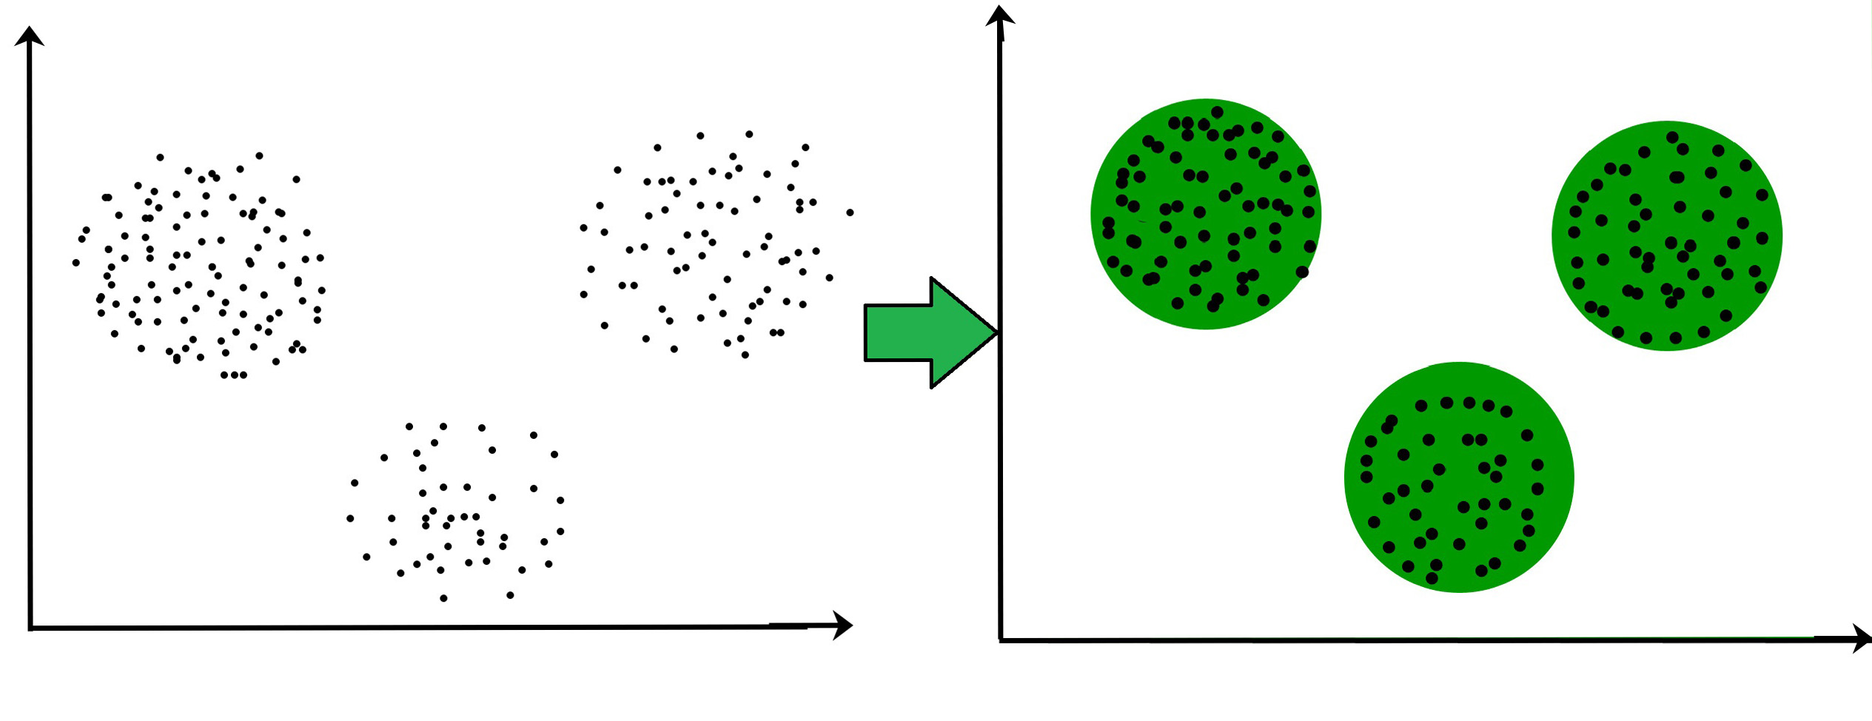
WHAT IS CLUSTERING?
Dividing the unlabelled population or data points into a number of groups which has more similarity to other data points..

Slide 31
Possible Applications
Marketing: Finding group of customers with similar behaviour given a large database of their properties and past buying records
Insurance: Identifying groups of motor insurance policy holders with a high average claim cost; identifying frauds.
Finance: Allocating weight of asset in investment

Slide 32
Hierarchical Clustering and its Varian
Type of Clustering Algorithm
KMeans Clustering
Connectivity Models
Centroid Models
Distribution Models
Density Models
Expectation – Maximization
DBSCAN and OPTICS

Slide 33
Without K-Means Clustering
With K-Means Clustering

Slide 34
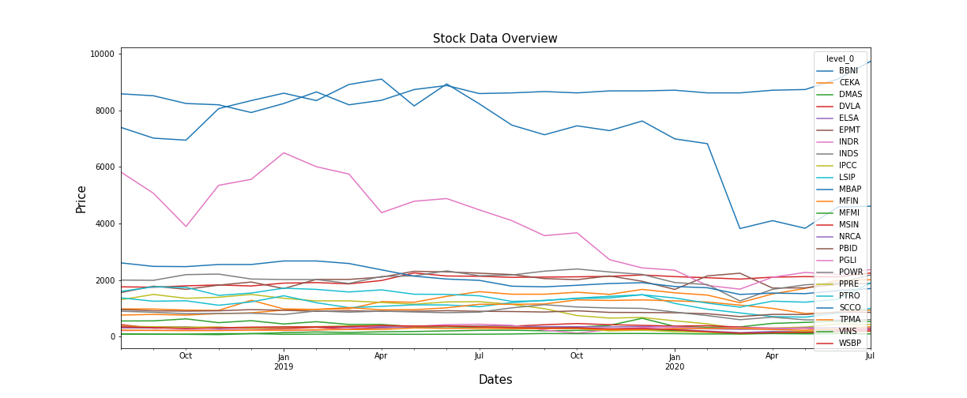
Without K-Means Clustering - Stock Data Overview

Slide 35
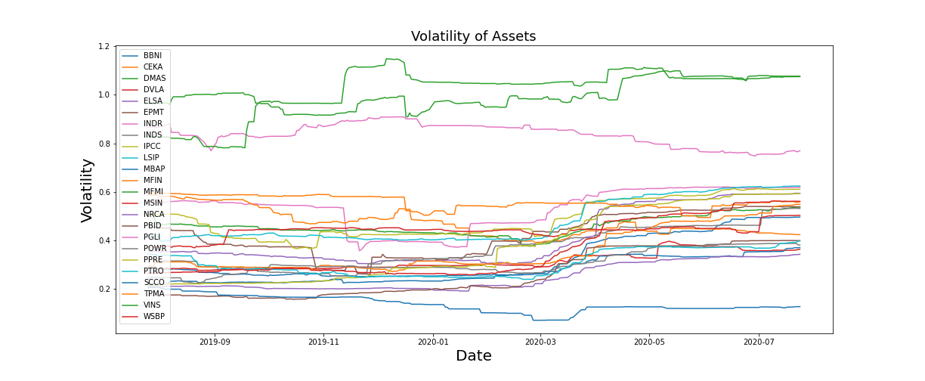
Without K-Means Clustering - Volatility Overview

Slide 36
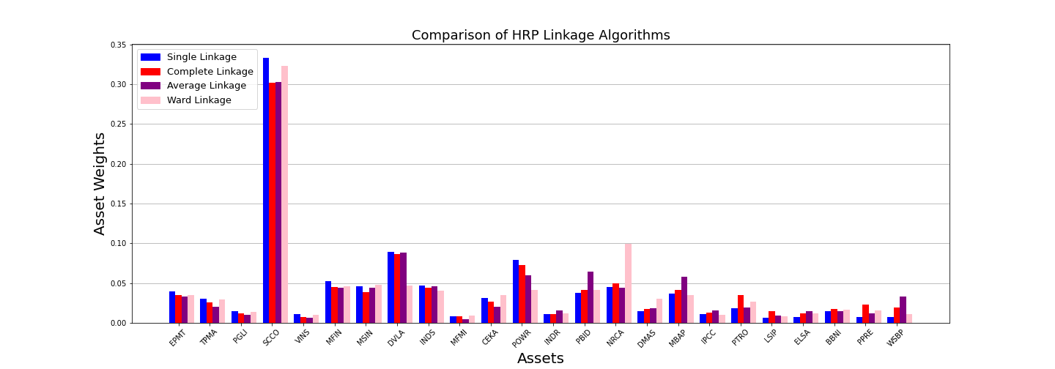
Without K-Means Clustering – Comparison HRP Portfolio Weights using all algorithm Linkage

Slide 37
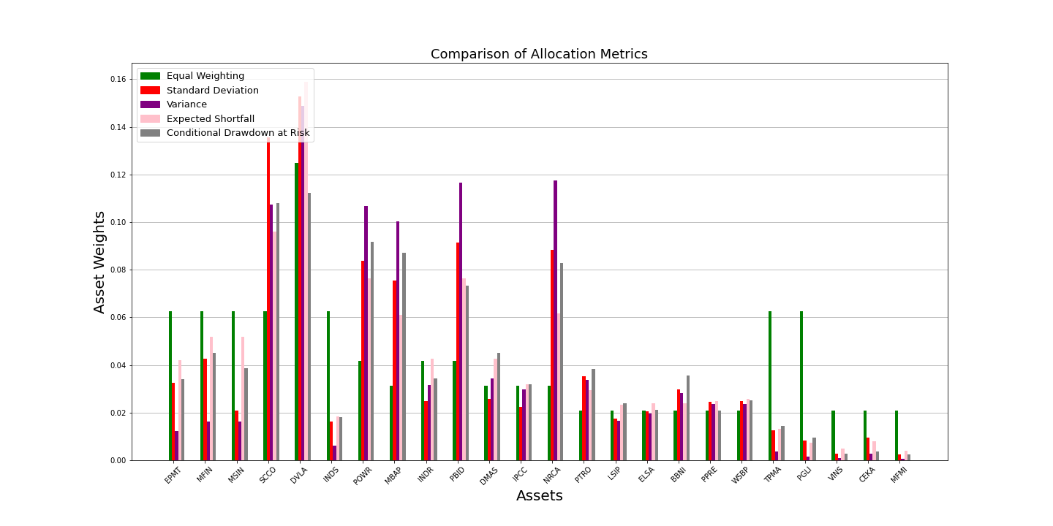
Without K-Means Clustering – Comparison HERC Portfolio Weights using all algorithm Risk Metrics

Slide 38
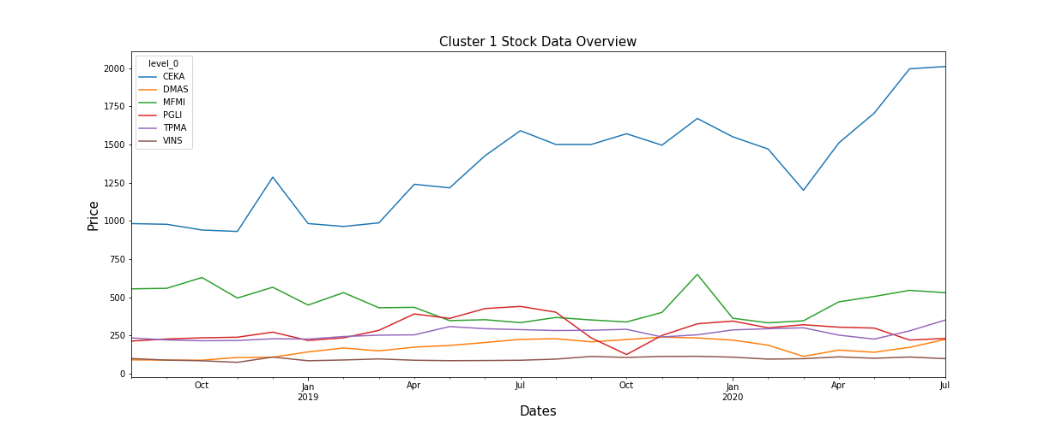
With Clustering – Cluster 1 Stock Data Overview

Slide 39
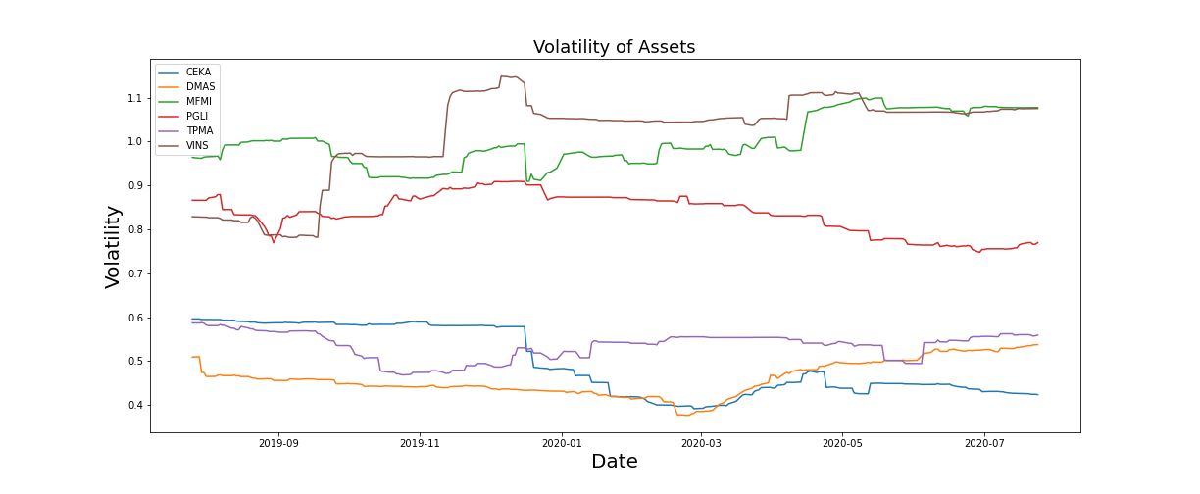
With Clustering – Cluster 1 Volatility

Slide 40
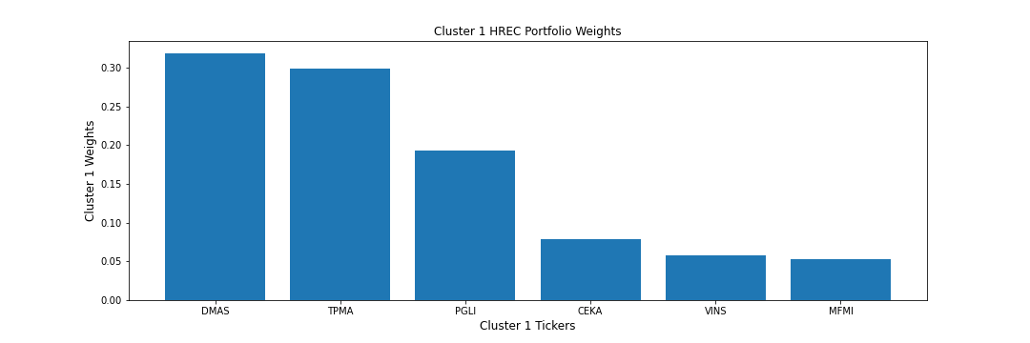
With Clustering – Cluster 1 Portfolio Weights using CDaR Risk Measure

Slide 41
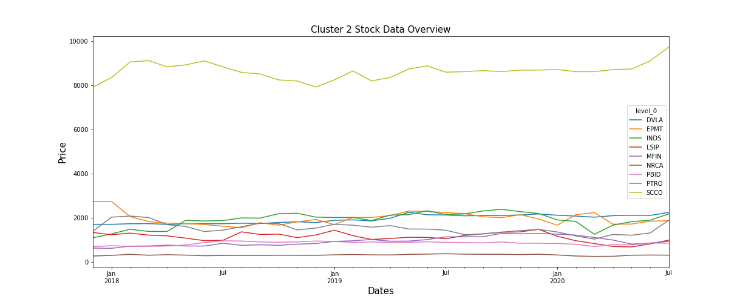
With Clustering – Cluster 2 Stock Data Overview

Slide 42
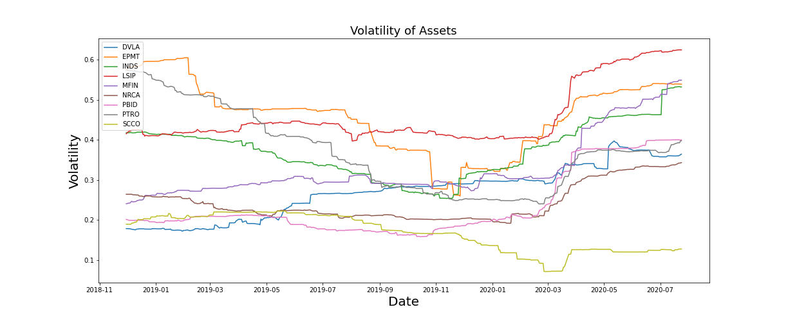
With Clustering – Cluster 2 Volatility

Slide 43
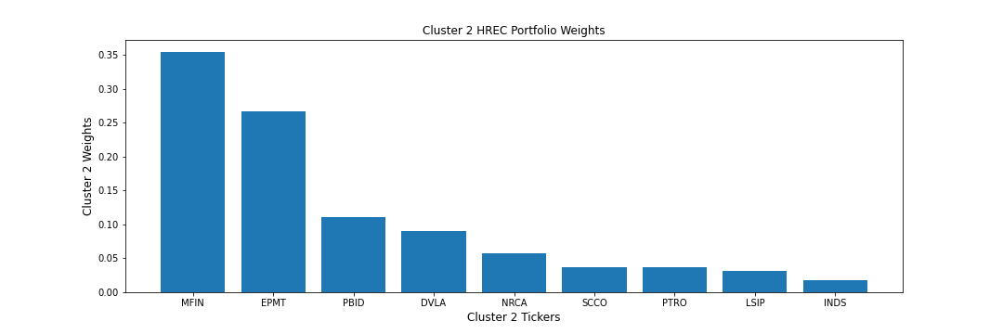
With Clustering – Cluster 2 Portfolio Weights using CDaR Risk Measure

Slide 44
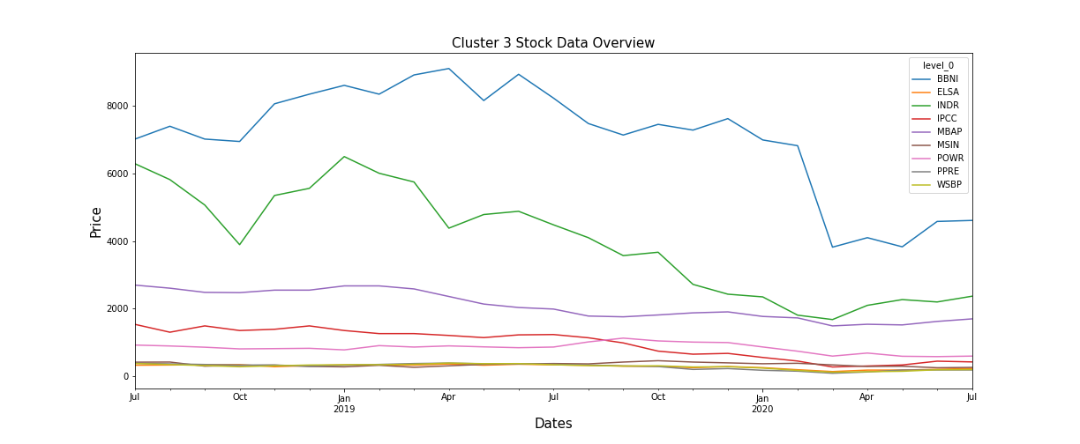
With Clustering – Cluster 3 Stock Data Overview

Slide 45
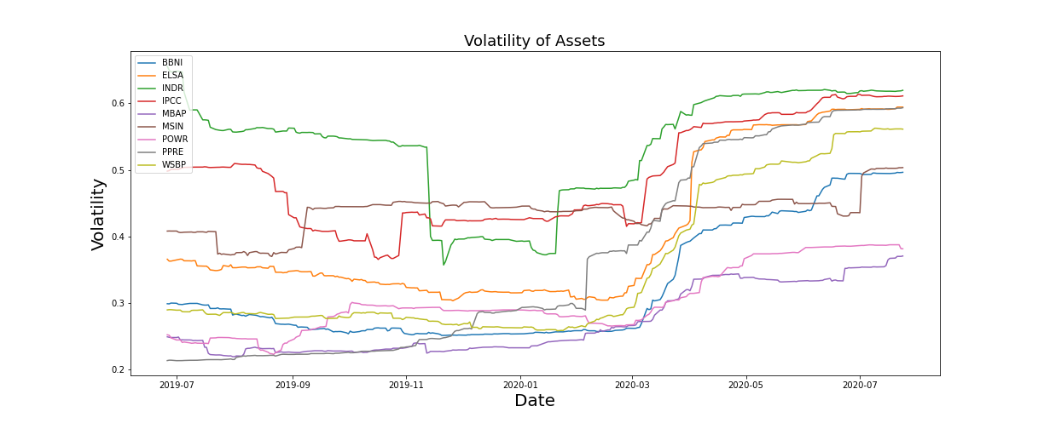
With Clustering – Cluster 3 Volatility

Slide 46
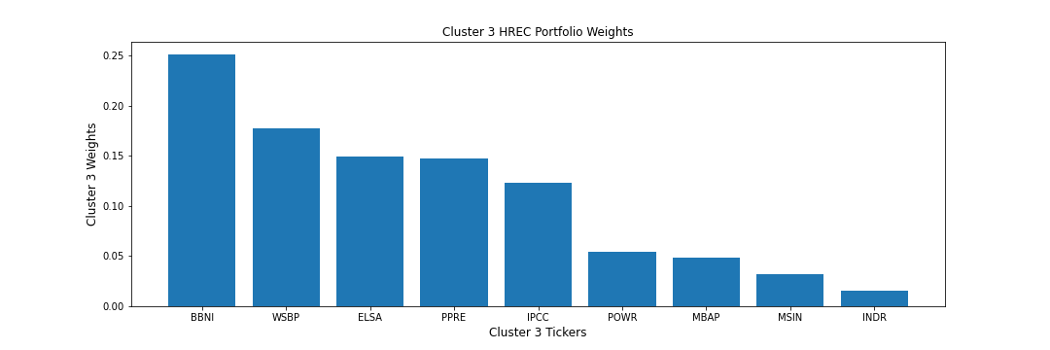
With Clustering – Cluster 3 Portfolio Weights using CDaR Risk Measure

Slide 47
Evaluation Metrics ^{[1] [2]}
Conditional Drawdown at Risk Metrics – The average of all drawdowns or cumulative losses in excess of a certain threshold
Expected Shortfall Risk Metrics – The expected return on the portolio in the worst q% of cases
Variance at Risk Metrics – The estimator how much a set of investments might lose (with a given probability), given a normal market conditions, in a set time period.
Sharpe Ratio – The average return earned in excess of the risk free rate per unit of volatiity or total risk
Probabilistic Sharpe Ratio - The probability that the estimated Sharpe Ratio exceeds a benchmark Sharpe Ratio
Information Ratio – The portfolio return beyond the returns of the a benchmark, usually an index, compared to the volatility of those returns
Minimum Record Length – The time period how long a track record should be in order to have statistical confidence that its Sharpe rato is above a given threshold
Bets Concentration - The uniformity of returns from bets. The closer the concentration is to 0, the more uniform the distribution of returns.

Slide 48
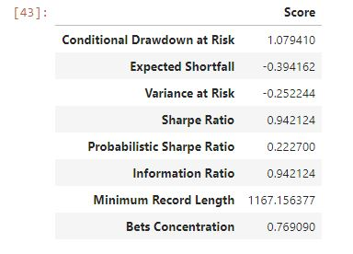
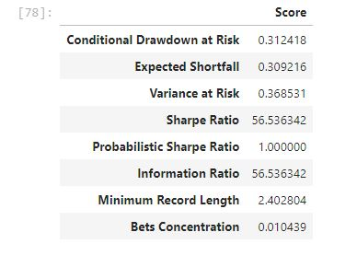
Without K-Means Clustering
With K-Means Clustering (Cluster 1)

Slide 49
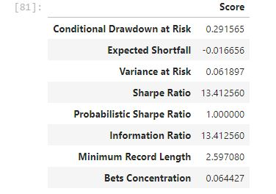
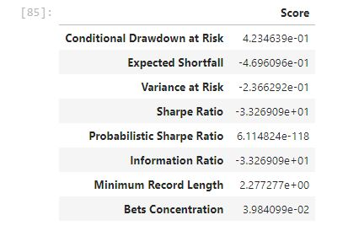
Portfolio Selection with K-Means Clustering (Allocation Algorithm with HERC, HRP, Inverse Variance and CLA Algorithm
Cluster 1
Cluster 2
Cluster 3

Slide 50
Conclusion
Every portfolio selection and allocation method has advantage and disadvantage sides. Investor needs to make assesment for their own risk profile.
Portfolio selection with K-Means Clustering has a better way solution in avoiding high risk yet with high return than without K-Means Clustering
Portfolio in Cluster 1 has better sharpe ratio but still has high variance at risk and conditional drawdown at risk compared to Cluster 2 and Cluster 3.
Cluster 3 has less risk than Cluster 1 and Cluster 2 but lower gain than Cluster 1 and Cluster 2.
Cluster 2 has more moderate risk metrics than Cluster 1 but higher gain than Cluster 3
Every portfolio selection and allocation method depends on stock price correlation, covariance matrix and financial stats for each company. That’s why investor needs to try different approach in finding a way to diversify and calculate risk – return based portfolio

Slide 51
Future Development
Live connected to IDX server so we can update data timeframe within day (even second!)
There is no stock market or portfolio analysis startup with these deep statistical tools and metrics analysis yet. These portfolio may be combined with another instrument so held minimum potential risk with higher gain result.
These model can be modified or developed for some purpose in financial sector.
We can make portfolio selection based on volatility via K-Means Clustering

Slide 52
Thanks!
Any questions?
You can find me at @aprianimmanuel or immanuelaprian@gmail.com

Slide 53
SlidesCarnival icons are editable shapes.
This means that you can:
Resize them without losing quality.
Change line color, width and style.
Isn’t that nice? :)
Examples:

Slide 54
Diagrams and infographics

Slide 55
😉
Now you can use any emoji as an icon!
And of course it resizes without losing quality and you can change the color.
How? Follow Google instructions https://twitter.com/googledocs/status/730087240156643328
✋👆👉👍👤👦👧👨👩👪💃🏃💑❤😂😉😋😒😭👶😸🐟🍒🍔💣📌📖🔨🎃🎈🎨🏈🏰🌏🔌🔑 and many more...

